Slide 1
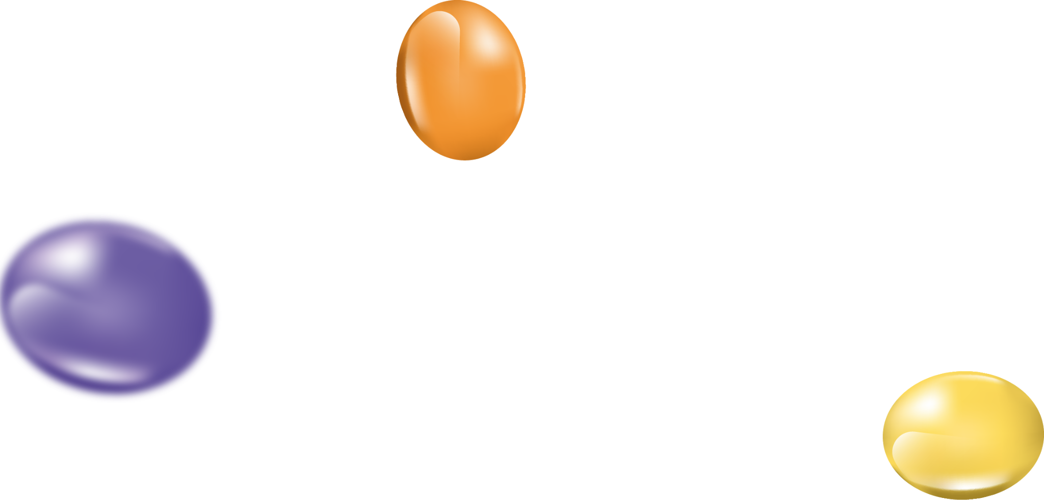
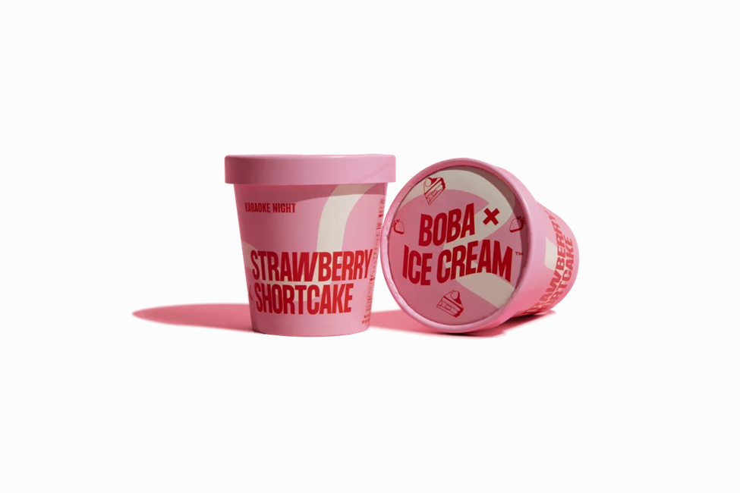
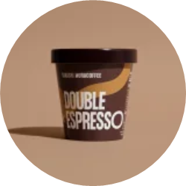


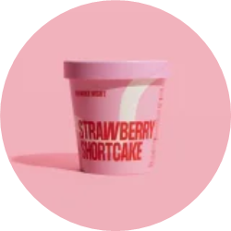


BOBA
X
ICE CREAM

Slide 2

OUR TEAM MEMBERS
1. Loh Shin Teng-BSE2250099
2. Goh Chi Hui-BSE2350125
3. Kwek Sok Xian-BCS2250088

Slide 3
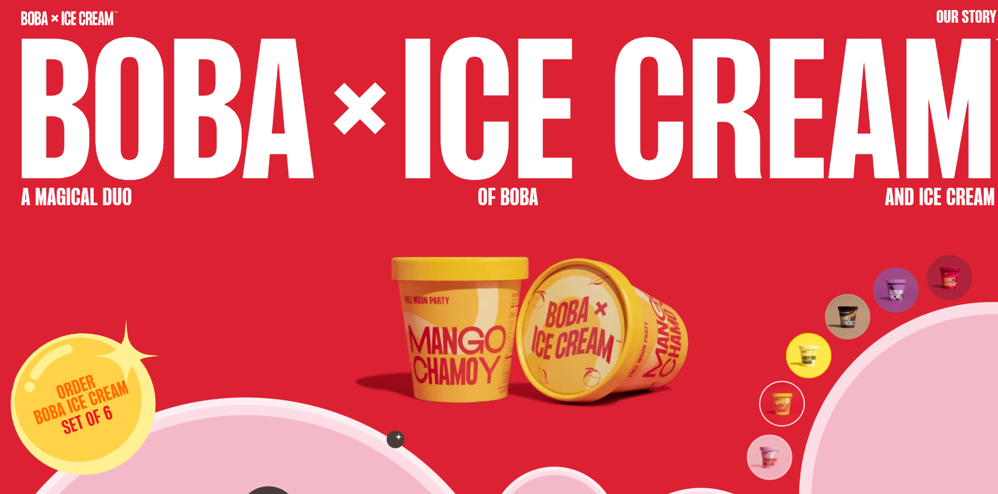
This is the website we choose
https://us.bobaicecream.com/

Slide 4

01
Introduction

Slide 5
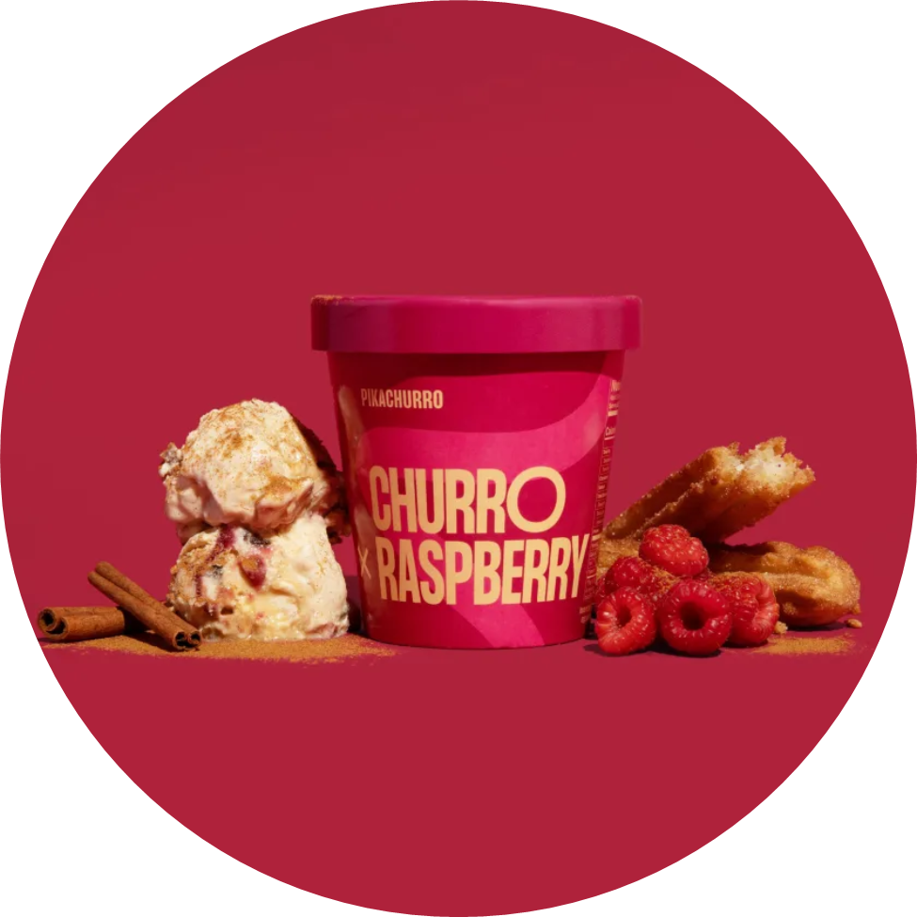
MISSION
We believe food has the power to unite people and deliver happiness.

Slide 6


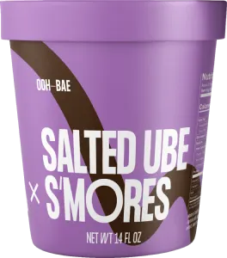
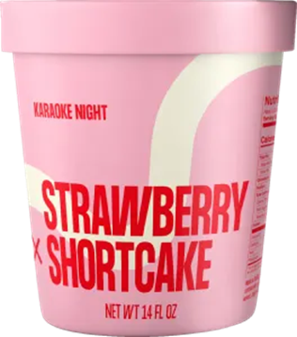


WHY WE CHOOSE THIS WEBSITE?
REASON:
This website very beautiful and colorful.
In the hot weather, just want to eat a ice cream.
Thinking of childhood memories.

Slide 7
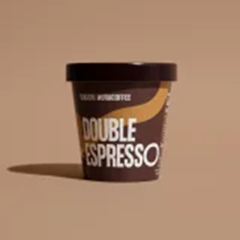


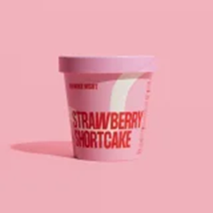
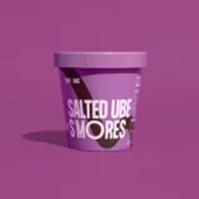
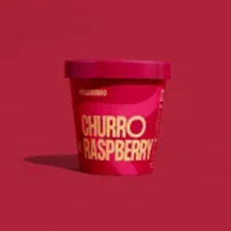
BOBA x ICE CREAM
MAIN PURPOSE
- Promote their company's unique ice creams.
THE TARGETED AUDIENCE
-Lactose intolerant patients

Slide 8

02
Content

Slide 9
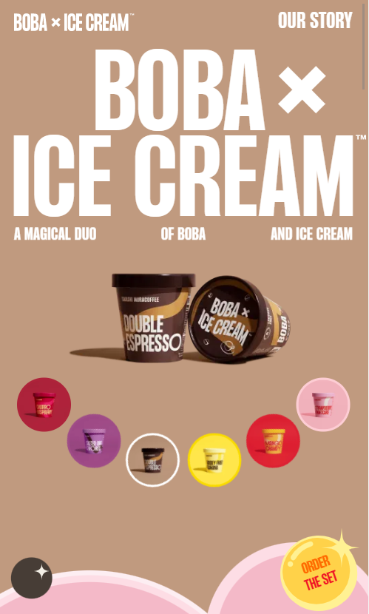
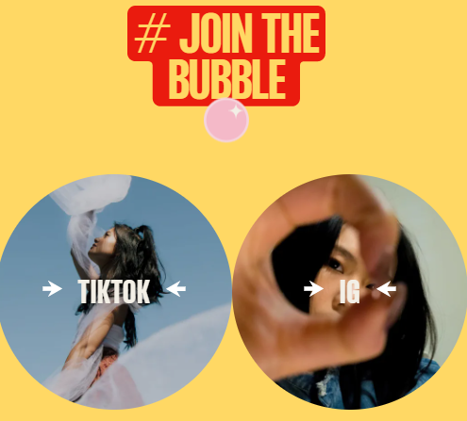
Homepage
•Can make order
•Product is Boba mix Ice cream, have 6 flavor
•Have social media in TikTok and Instagram

Slide 10
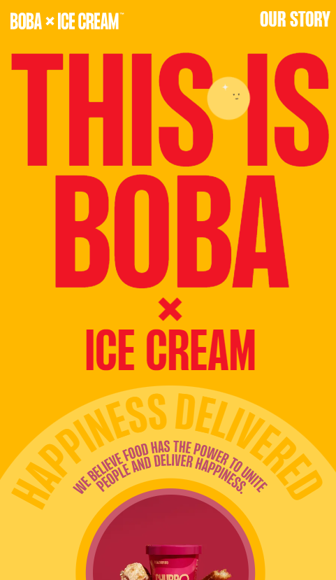

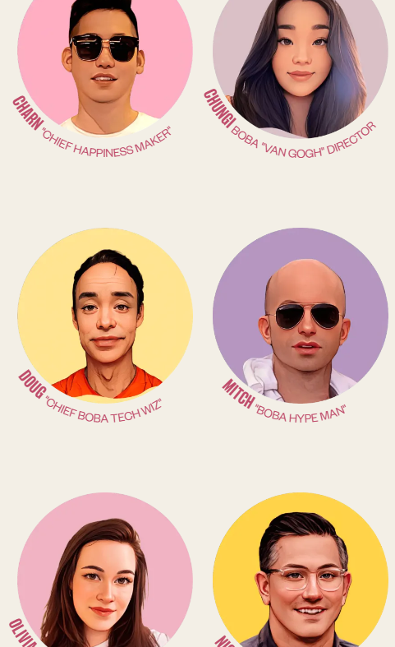
Our story page
•Mission and vision
•The ice cream is 100% lactose free
•Founder and the team

Slide 11
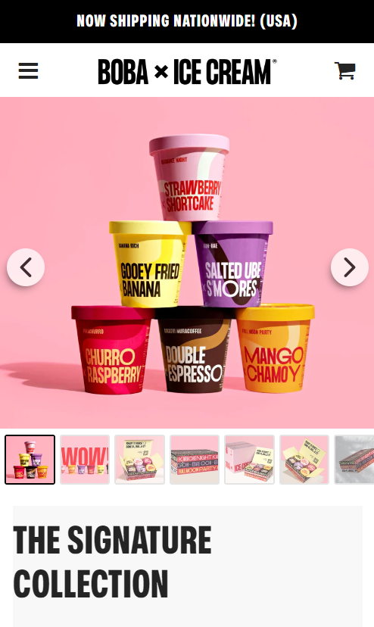
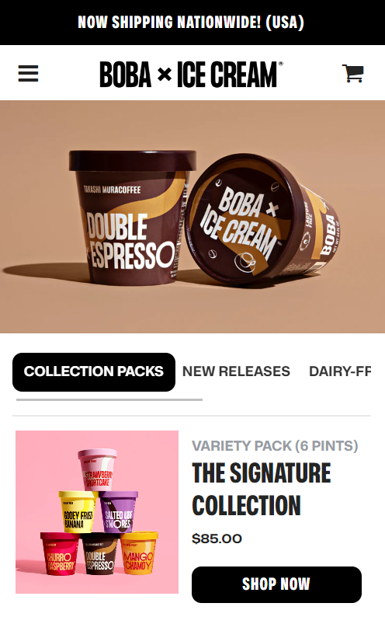
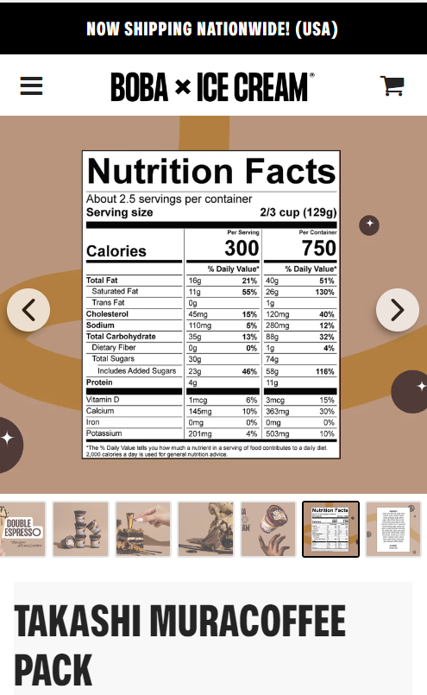
Shop page
•Make order and payment
•Choose the flavor
•Get more detail about the ingredients and nutritions

Slide 12
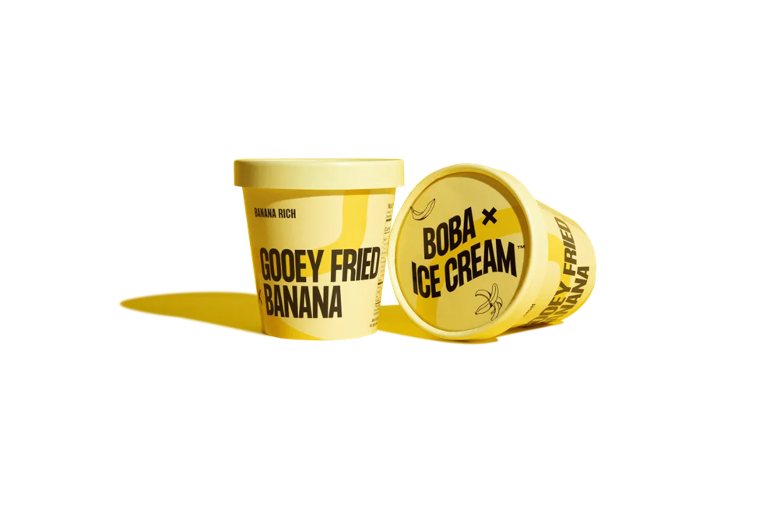

Advantages
Short and simple
Easy to understand and the information is very clear
There are no long paragraph so user can easily read
The content is interesting because the animation and the font makes the content more eye catching

Slide 13
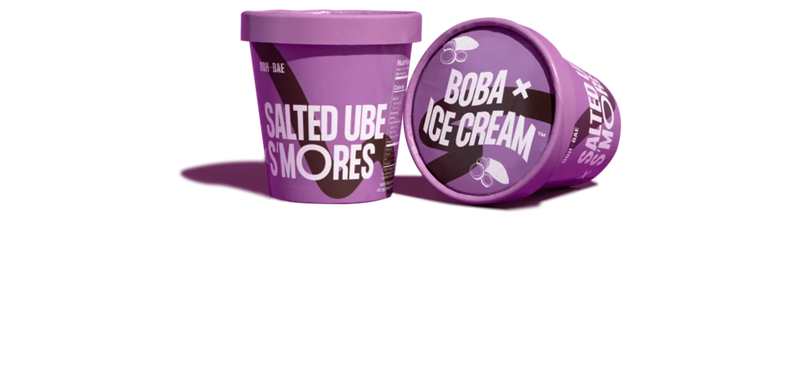
Lacking
The background and history of the company, founder and the team
It does not show what the ice cream look like
Does not show whether ice cream contain real fruit or jelly or colouring
Suggestions
Add more details to introduce about the company history
Add some picture to show inside the ice cream eg,real fruit
Add some music

Slide 14
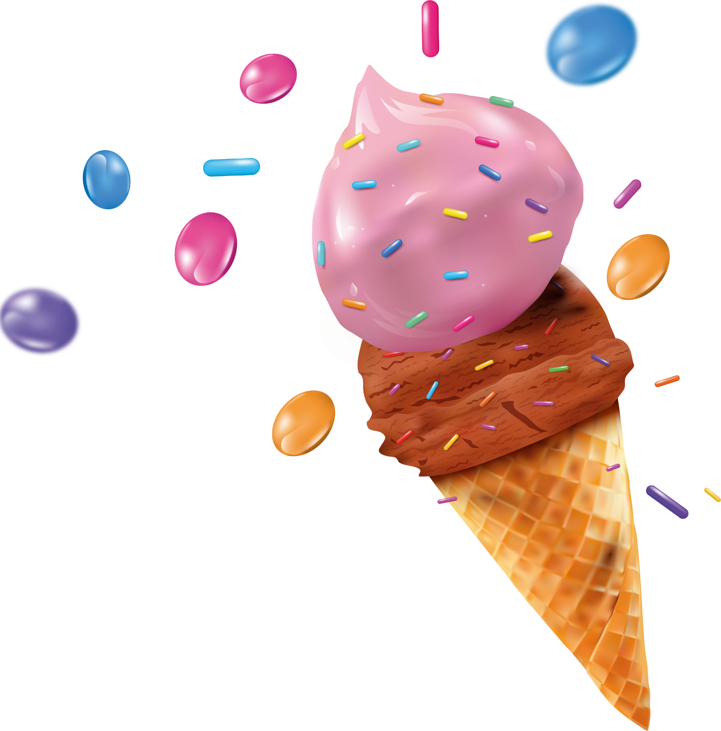
03
User Experience & Design

Slide 15

User Experience
Disadvantages
inconvenient for the computers user
-cannot see the whole information
-inconvenient to turn the page
The design of "our story" is too monotonous and easy to be ignored

Slide 16
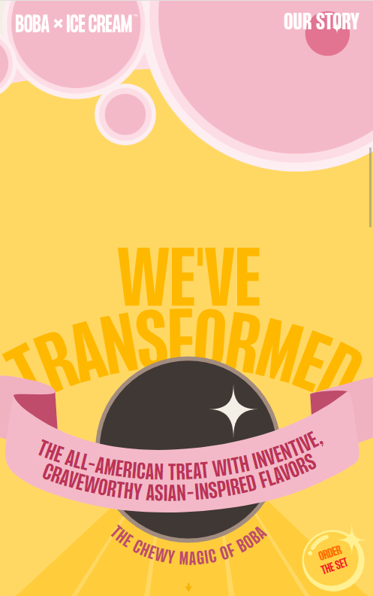
User Experience
Advantages
Perfectly match the mobile phone
The use process is very smooth
Although there is some animation but no need to wait for loading
Suggestion
Adjust the overall proportion and size for computer users
Modify the icon of our story

Slide 17
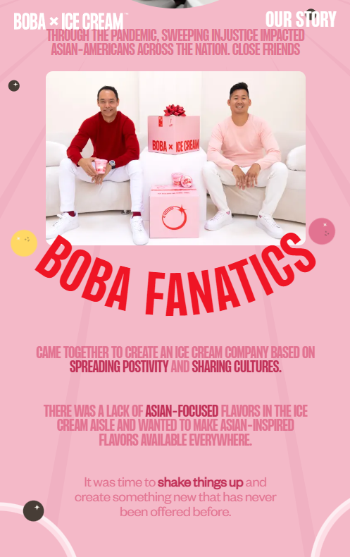
Design
Advantages
The overall use of bright colors makes people feel very comfortable
makes people know what is the point
-Different font size
-Different colors
Attractive animation

Slide 18
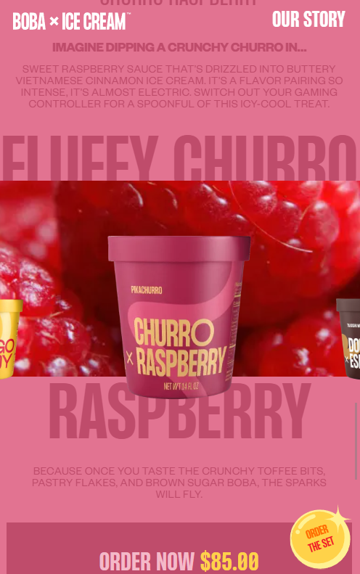
Design
Disadvantages
Some words are unclear
-font size
-colors
Suggestion
Change the color and font size of words

Slide 19

Thank you!

